Slide 1
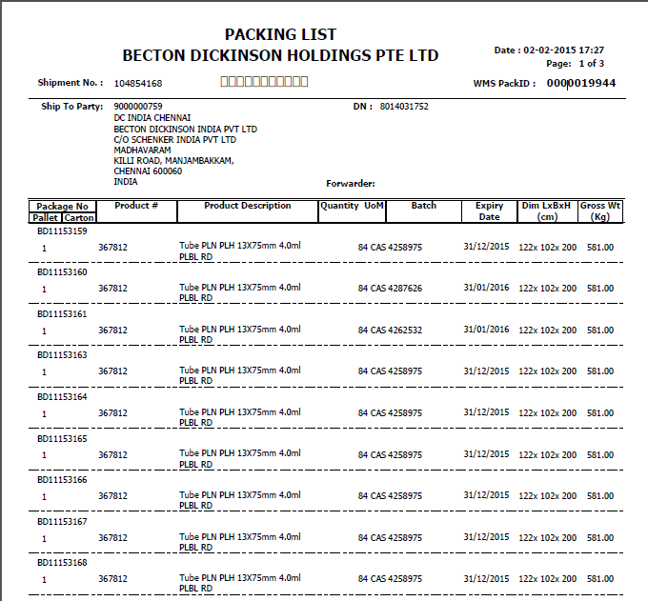

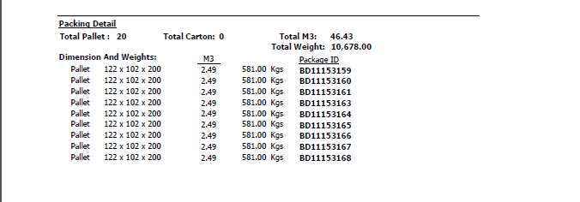
Net Wt
(Kg)
564.00
564.00
564.00
564.00
564.00
564.00
564.00
564.00
564.00
To add total Net Wt in packing details

Slide 2
